Slide 1
Chapter 6
The Enlightenment
State Standard
10.1.3, 10.2.1, 10.2.2, 10.2.3

Slide 2

Enlightenment in Europe (1700’s)
Intellectual movement
  Stressed reason & thought & power of individual.
  Age of Reason
  Promoted:
    Belief in progress
    More secular outlook
    Faith in science
  Turning Point
    Europeans changed their way of thinking about the role of government

Slide 3
Philosophers
People can apply reason to all aspects of life.
Five Concepts of their core beliefs:
  Reason – truth discovered through reason or logical thinking
  Nature – what is natural is good & reasonable
  Happiness – should seek well-being on earth
  Progress – society & humankind could improve
  Liberty – called for liberties won during Bill of Rights & Glorious Revolution.

Slide 4
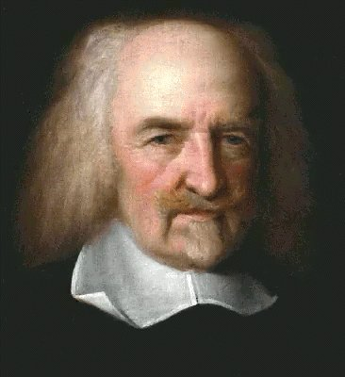
Thomas Hobbes – English political thinker
  He said humans are naturally selfish & wicked
  Government creates order
  People hand over rights to strong ruler, exchange gain law and order (Social Contract)
  Favored absolute monarchy

Slide 5
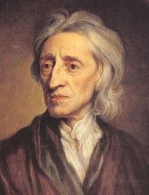
John Locke – English political thinker
  Favored self-government
  All people have right to life, liberty, & property
    Purpose of government to protect peoples rights
    People have the right to rebel against an oppressive government.
  Said the most fundamental duty of government was to protect the rights of its citizens.

Slide 6
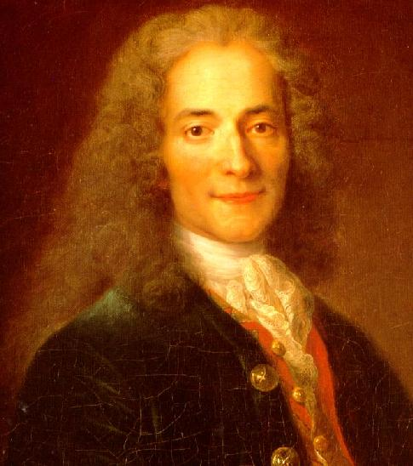
Voltaire
French writer
Used satire against opponents
Wrote 70 books
Fought for tolerance, reason, freedom of religion, and freedom of speech

Slide 7
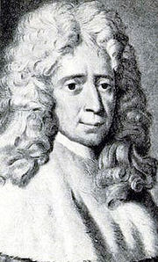
Charles-Louis Montesquieu
French writer
Believed Britain best-governed & political balanced country.
Proposed “Separation of Powers” – can prevent tyranny by acting as a check on power
He influenced the US Constitution-3 branches of government
  Legislative branch – makes laws
  Executive branch – carry out laws
  Judicial branch – interpret laws

Slide 8
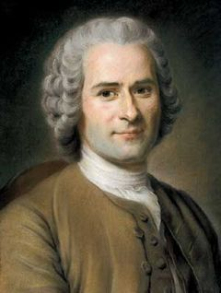
Jean Jacques Rousseau
French writer
Disagreed with other thinkers
“Civilization corrupted people’s natural goodness”
  Only good government - freely formed by people & guided by “general will” of society.
“Social Contract”
  Agreement between people and their government.
  All people are equal & titles of nobility should be abolished.

Slide 9
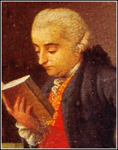
Bonesana Beccaria
Italian philosopher
Believed laws existed to preserve social order, not avenge crimes
  Said that a Person accused of crime should receive a speedy trial
  Said torture should be outlawed
  Thought laws existed to keep order
  Degree of punishment should fit crime
Believed capital punishment should be abolished
Based belief on idea that governments should seek the greatest good for the greatest number people

Slide 10
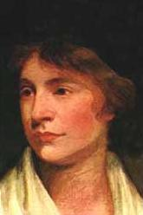
Women & the Enlightenment
Mary Astell - wrote “A Serious Proposal to the Ladies” – addressed lack of educational opportunities for ladies
  “If all men are born free, how is it that all women are born slaves?”
Mary Wollstonecraft - wrote essay “A Vindication of the Rights of Women” – women like men, should devote themselves to education to become virtuous and useful.

Slide 11



Slide 12
Thomas Hobbes believed that people:
Should have freedom of expression
Are selfish and wicked
Should have natural rights
Are kind and generous

Slide 13
Thomas Hobbes believed that people:
Should have freedom of expression
Are selfish and wicked
Should have natural rights
Are kind and generous

Slide 14
John Locke argued that people:
Are by nature selfish and ambitious
Are better off when they allow themselves to be ruled by a monarch
Use their intuition to make sense of their experiences
Have the right to rebel against an oppressive government

Slide 15
John Locke argued that people:
Are by nature selfish and ambitious
Are better off when they allow themselves to be ruled by a monarch
Use their intuition to make sense of their experiences
Have the right to rebel against an oppressive government

Slide 16
Montesquieu developed which of the following ideas:
Freedom of speech
Separation of powers
Freedom of expression
Religious freedom

Slide 17
Montesquieu developed which of the following ideas:
Freedom of speech
Separation of powers
Freedom of expression
Religious freedom

Slide 18
Rousseau believed that the only good government was one that:
Was freely formed by the people
The nobility should be the decision-making branch of the government
The rights of the individual are limited
Needs one absolute ruler

Slide 19
Rousseau believed that the only good government was one that:
Was freely formed by the people
The nobility should be the decision-making branch of the government
The rights of the individual are limited
Needs one absolute ruler

Slide 20
The Enlightenment idea of a social contract was an agreement between:
Nations
God and humanity
Church and the government
Free individuals to create a society and a government

Slide 21
The Enlightenment idea of a social contract was an agreement between:
Nations
God and humanity
Church and the government
Free individuals to create a society and a government

Slide 22
Locke and Rousseau would be most likely to support:
A return to feudalism in Europe
A government ruled by a divine right monarchy
The right of citizens to decide the best form of government
A society ruled by the Catholic Church

Slide 23
Locke and Rousseau would be most likely to support:
A return to feudalism in Europe
A government ruled by a divine right monarchy
The right of citizens to decide the best form of government
A society ruled by the Catholic Church

Slide 24
What did Voltaire NOT fight for?
Tolerance
Freedom of religious belief/speech
Women’s rights
Reason

Slide 25
What did Voltaire NOT fight for?
Tolerance
Freedom of religious belief/speech
Women’s rights
Reason

Slide 26
In her writings, Mary Wollstonecraft argues that:
The liberating promise of the French Revolution must be extended all people
British life is threatening by the revolutionary chaos in France
Burke is correct in his defense of inherited privilege
Women should devote themselves to education

Slide 27
In her writings, Mary Wollstonecraft argues that:
The liberating promise of the French Revolution must be extended all people
British life is threatening by the revolutionary chaos in France
Burke is correct in his defense of inherited privilege
Women should devote themselves to education

Slide 28
John Locke believed that the most fundamental duty of government was to:
Protect the rights of its citizens
Keep out foreign invaders
Regulate trade
Hold elections

Slide 29
John Locke believed that the most fundamental duty of government was to:
Protect the rights of its citizens
Keep out foreign invaders
Regulate trade
Hold elections

Slide 30
What did Beccaria NOT believe in?
Torture should be outlawed
People accused of a crime should have a speedy trial
Capital punishment should be allowed
Laws existed to keep order

Slide 31
What did Beccaria NOT believe in?
Torture should be outlawed
People accused of a crime should have a speedy trial
Capital punishment should be allowed
Laws existed to keep order

Slide 32
The Enlightenment Spreads
Section 3
Enlightenment ideals reflected in arts, music, literature, painting and architecture
  1700’s Paris cultural and intellectual capital of Europe and Americas.
Enlightenment ideas influenced:
  European thinkers, European artists and the literate middle class
  Swept through European society & colonial America
Thinkers gathered at Salons – social gatherings at mansions of wealthy women
  Denis Diderot – creates Encyclopedia
  Helped spread Enlightenment thinking

Slide 33
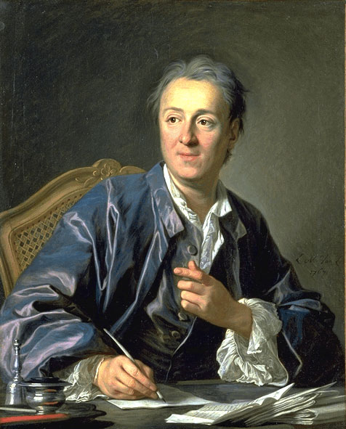


Slide 34
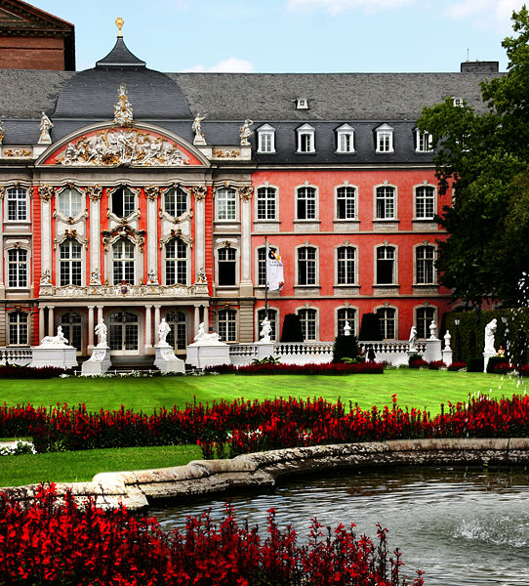
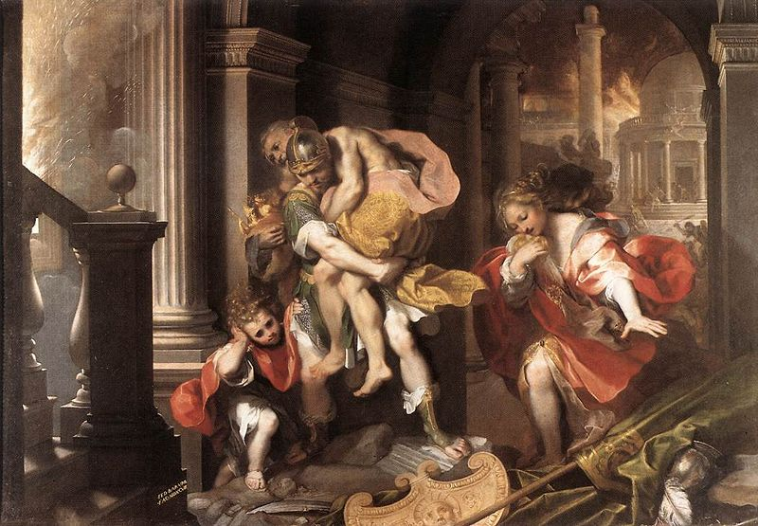
Neoclassical Style
“New classical”
  Emphasized elegance and simplicity
  Ideas of Greeks and Romans
Baroque style – Grand, ornate designs
  Dominated art of 1600s and 1700s

Slide 35
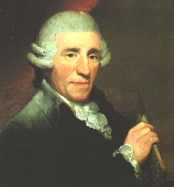
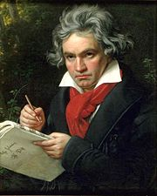
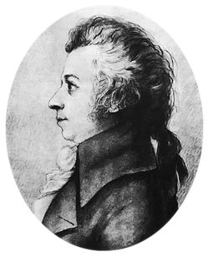
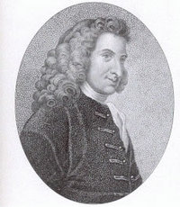
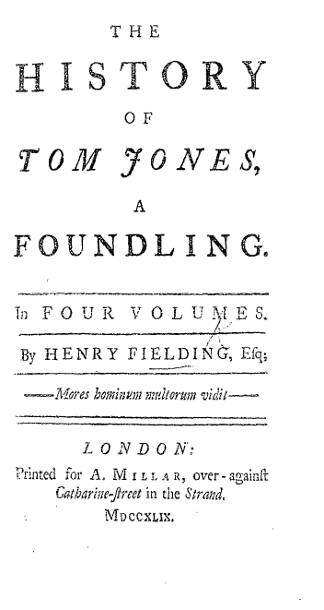
Music and Literature
New music style – classical
  Haydn, Mozart, Beethoven
  Composed music that was elegant and original.
Writers wrote novels
  Henry Fielding – Tom Jones
    Helped create many features of the modern novel

Slide 36
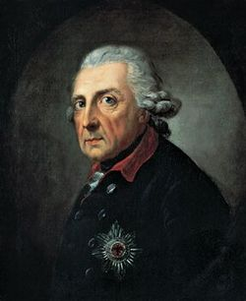
Enlightened despots - “Enlightened absolute rulers”
  Followed Enlightenment ideas but were unwilling to give up too much power.
Frederick the Great – king of Prussia (1740 to 1786)
  Granted religious freedoms, reduced censorship, improved education, reformed justice system, abolished torture.

Slide 37
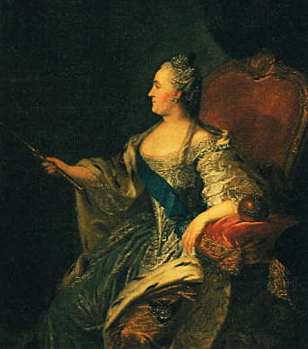
Catherine the Great – Russia (1762-1796)
  Read works of philosophers
    Led to proposals on reforms to Russia’s laws
    Wanted to end serfdom
    Gave power to nobles over serfs
  Allowed religious tolerance
  Abolished torture & capital punishment

Slide 38

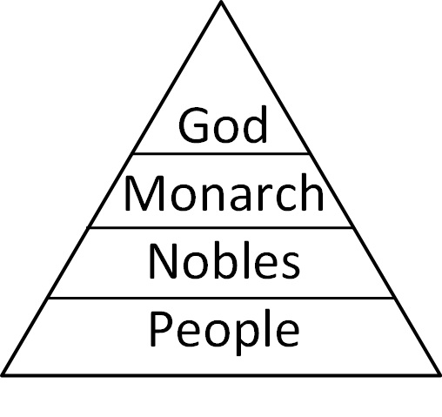
Theory of Absolutism
Absolute monarchs – kings or queens who held all of the power within their states boundaries. Use divine right to justify their power.
  Goal – control every aspect of society.
  Believed in divine right = idea that God created the monarchy. Monarch acted as God’s representative
    Absolute monarchs- the king ONLY answers to God.

Slide 39
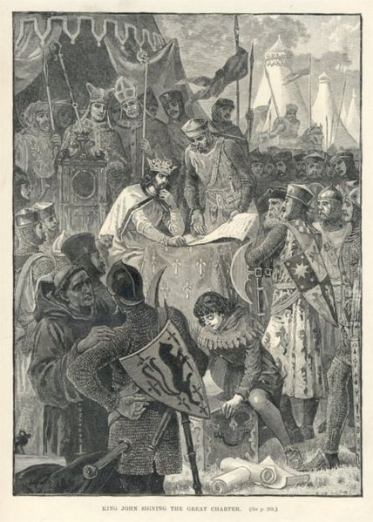
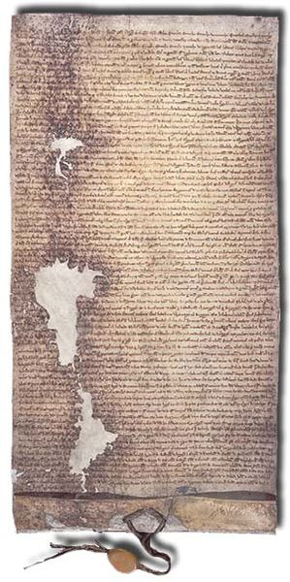

Slide 40
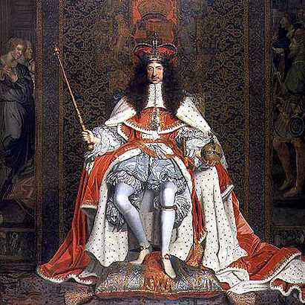
Charles I
Wanted money, taxed people
  Petition of Rights - demanded end to:
  Taxing without Parliaments consent
  Imprisoning citizens illegally
  Housing troops in citizens homes
  Maintaining army in peacetime
Charles signs to get funds, then ignores

Slide 41
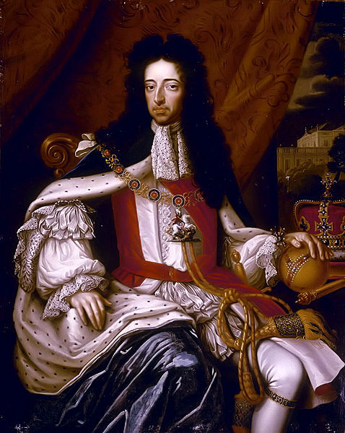
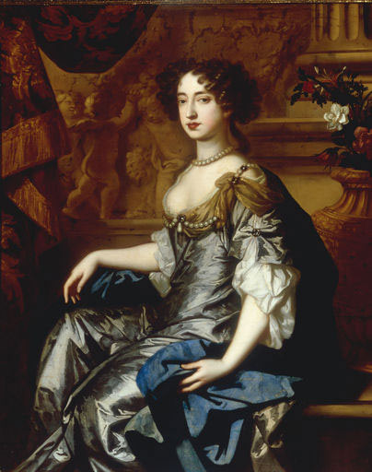
By 1689, the Glorious Revolution guaranteed that England's system of government had become a Constitutional Monarchy - powers of the ruler are restricted by the constitution & laws of the country.

Slide 42
English Bill of Rights
A formal summary of the rights and liberties believed essential to the people
Limited the monarchs power and guaranteed rights of the people.
Did not allow the monarch to suspend laws, to tax without Parliament’s consent, or to raise an army in peacetime
Assured people right to petition the King for grievances against the government
Excessive bail & cruel & unusual punishment were forbidden.

Slide 43
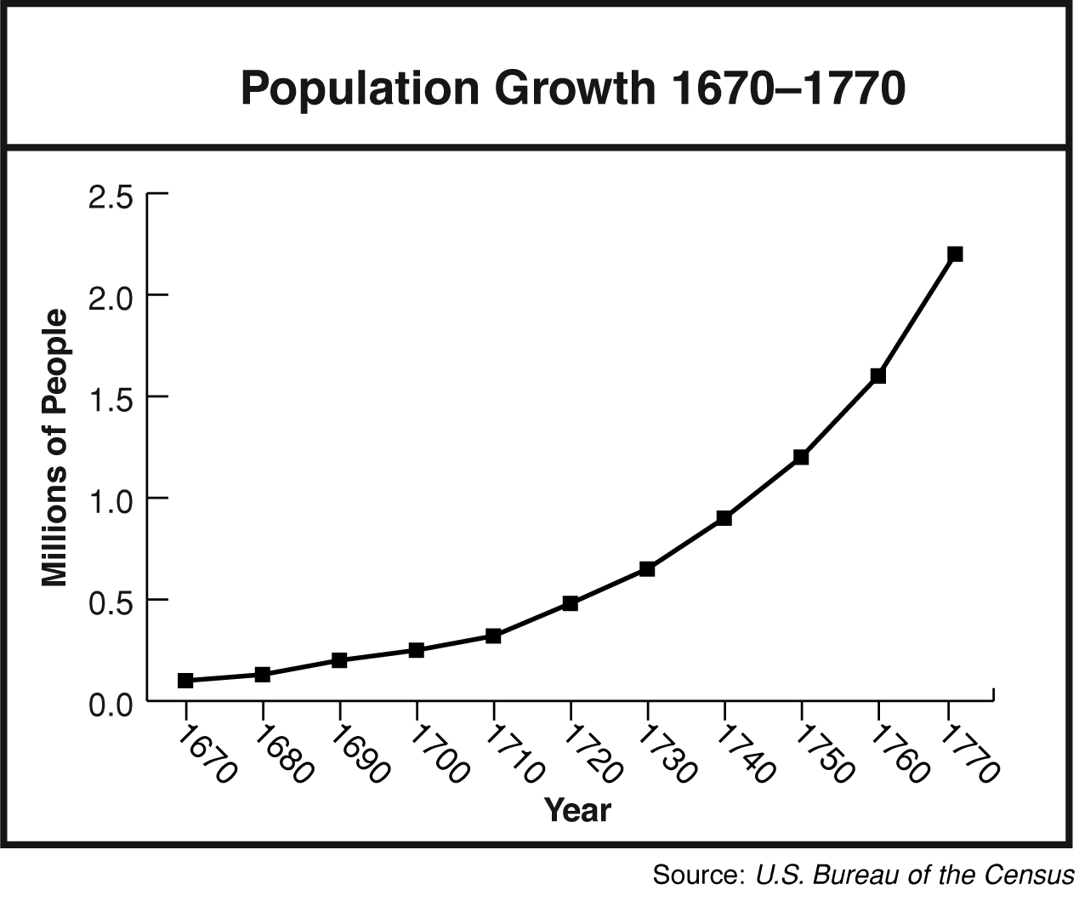
The American Revolution
Section 4
13 colonies population 250,000 (1700)
  2,150,000 (1770)
Formed own governments
  Thrived on trade with Europe.
  Still British subjects, subject to laws.
American Revolution influenced by: Enlightenment, Magna Carta, Greek/Roman democracies

Slide 44
British Parliament
1651, passed Navigation Act
  Trade law, could only sell most valuable products to Britain.
FRENCH and INDIAN WAR
  1754-1763, English & French fought in North America.
    Colonist allied with Britain
    British win, claim French territories.
    Britain expects colonist to pay for war.
    Taxed colonists, restricted settlements and limited self-government.

Slide 45

Sugar Act
Great Britain borrowed too much – doubled debt
1764, Sugar Act
  Placed duty on foreign-made molasses
  Attempted to reduce smuggling
Stamp Act
Pay tax for stamp on all printed
materials
Colonist outraged – violated natural
rights.
“Taxation without representation”

Slide 46
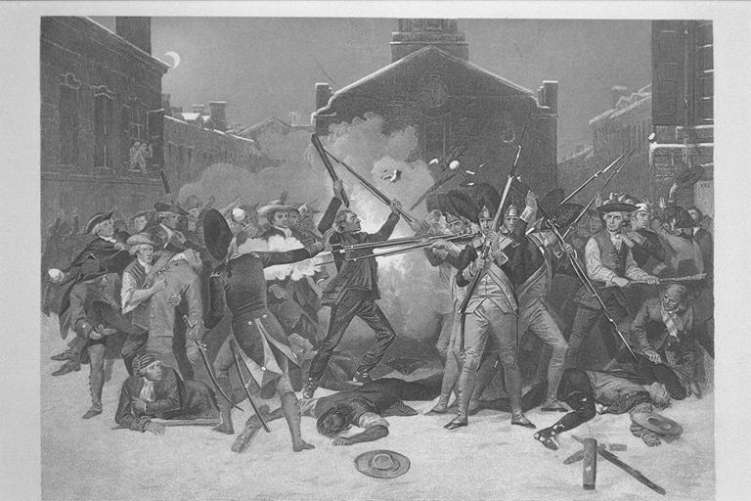
Boston Massacre
March 5, 1770
  Mob gathered at Boston Customs house.
  Soldiers fire on crowd
    5 killed
    Population outraged!

Slide 47
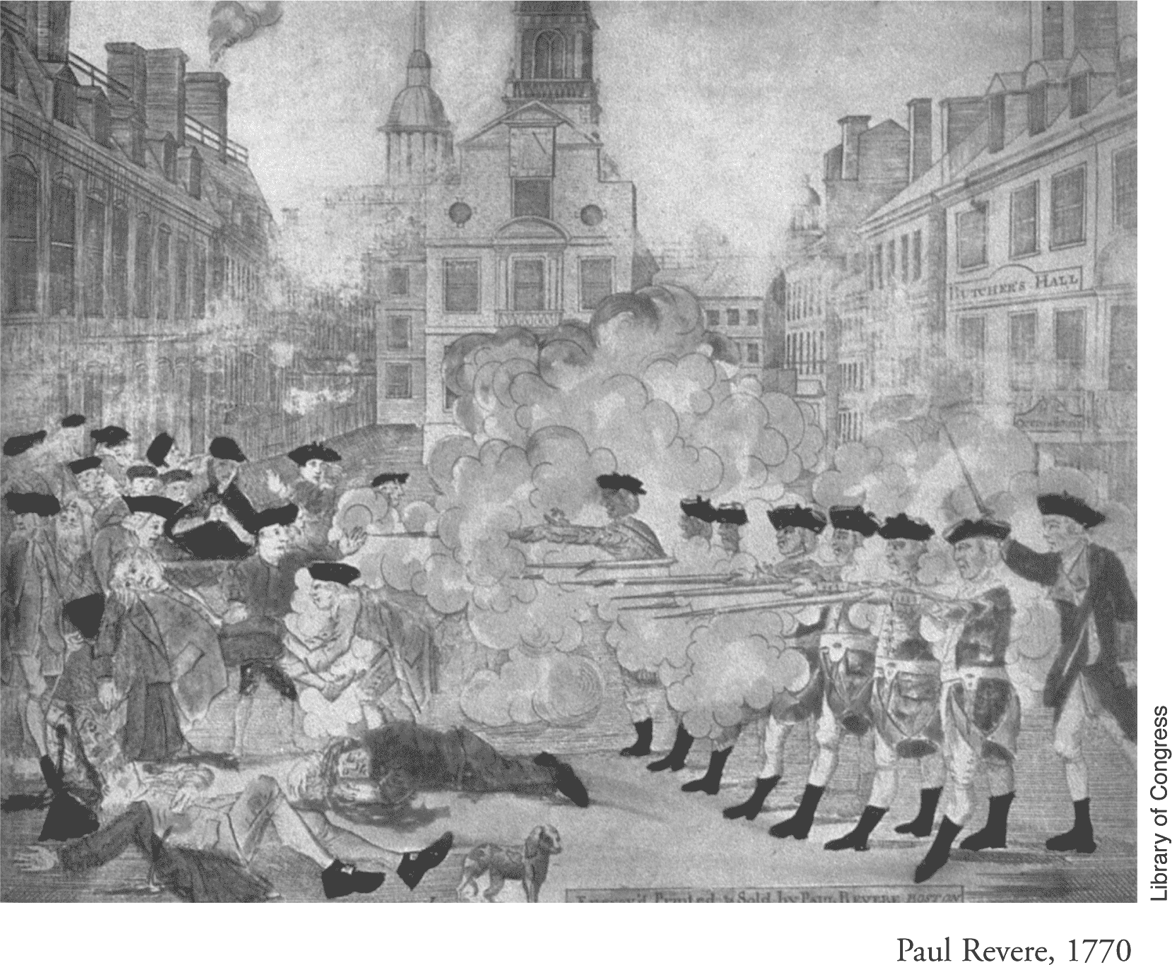

Slide 48
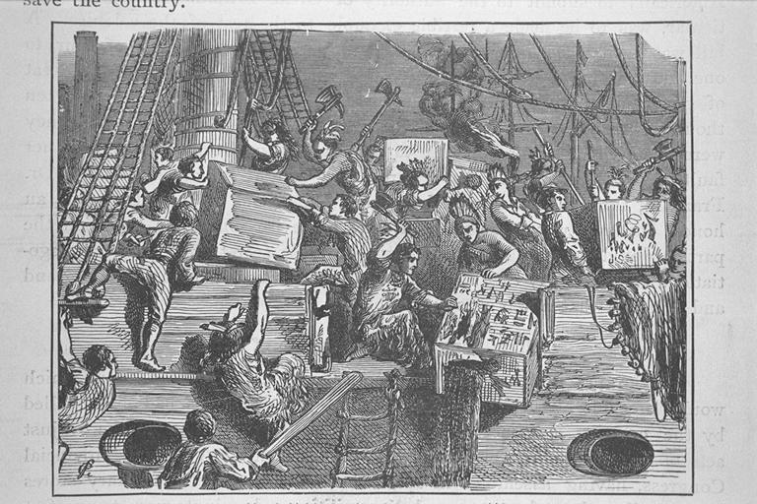
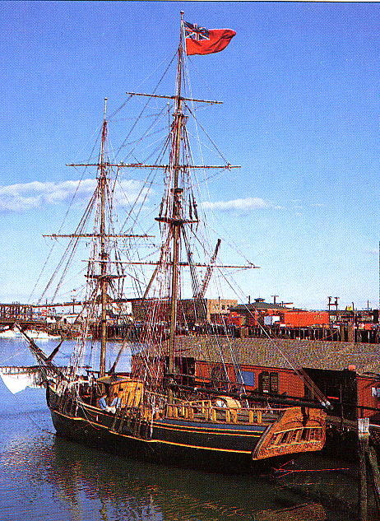
Boston Tea Party
British give East India Company special concessions in tea business.
Shuts out colonial tea merchants.
December 16, 1773
  Sons of Liberty protest.
Dressed as Indians
Dump tea into Boston Harbor.

Slide 49
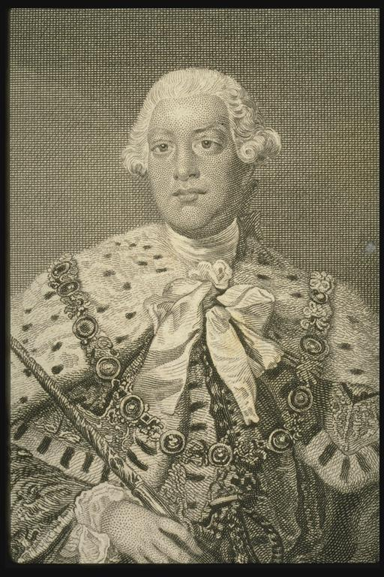
“Intolerable Acts”
The Royal Navy blockades the Boston Harbor so no colonial goods could be sent out until tea was paid for.
Colonists had to quarter (house) British soldiers.
King George assigned British General Gage to be Massachusetts governor.

Slide 50
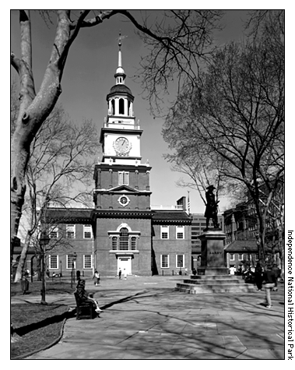
First Continental Congress
56 delegates from 13 colonies (except Georgia) gather in Philadelphia.
Declaration of Rights - agreed not to consume British goods
Set up a group to enforce the boycotts
Prepared for war

Slide 51
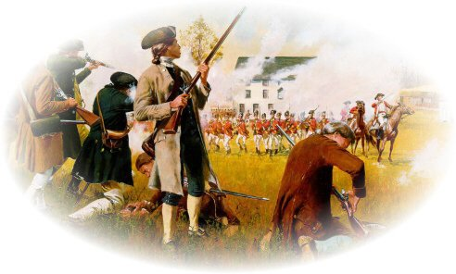
The Shot Heard Round the World

Slide 52
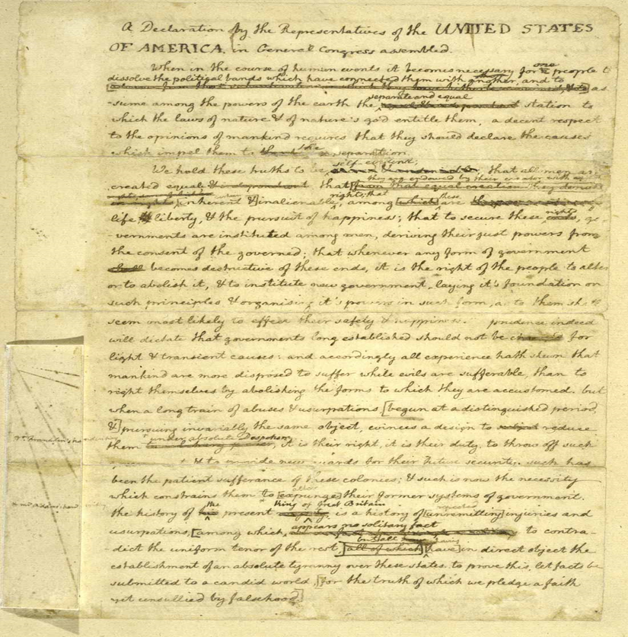
Declaration of Independence
July 4, 1776 - Continental Convention adopts Declaration of Independence
  Written by Thomas Jefferson
  Based on John Locke’s ideas
  Influenced by idea of individual rights from the Magna Carta
Embodied Englightenment Ideals
  “Life, Liberty, and the pursuit of Happiness”

Slide 53
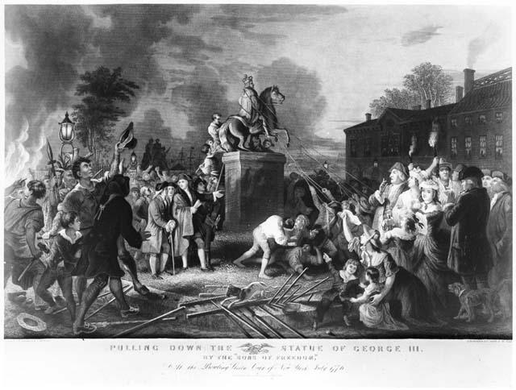
Reactions to July 4…

Slide 54
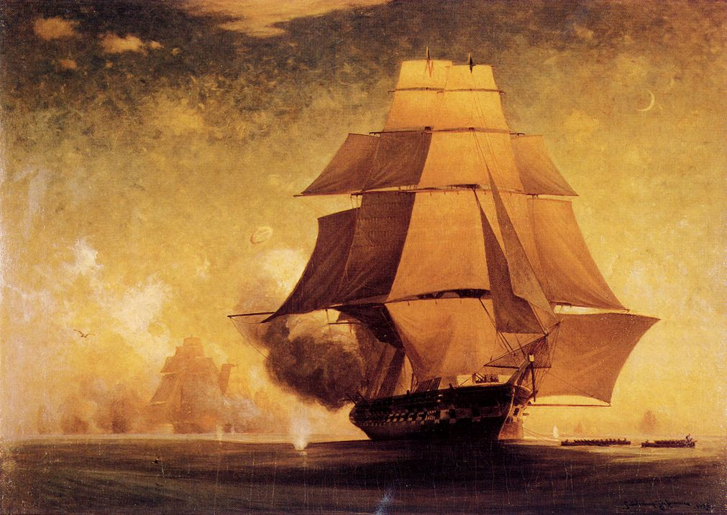
The American Revolution
1775-1783

Slide 55


Tale of the Tape
British Advantages
  Army of regulars
  Top Navy
  30,000 Hessians (German mercenaries)
  50,000 American loyalists – opposed independence, loyal to crown
  Money and supplies
American Advantages
  Patriots – supporters of independence
  3,000 miles of ocean
  Home Turf
  Fighting for independence
  Leadership
  Training in French & Indian War
  French assistance

Slide 56
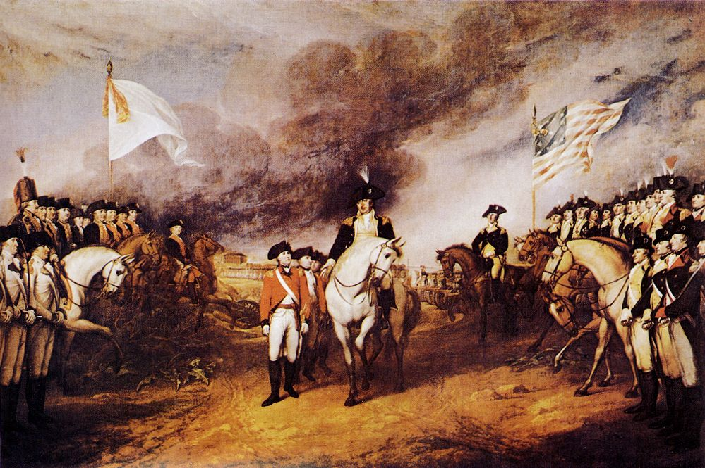
Battle of Saratoga
Most important event of war
  French enter war, sign alliance with US (1778)
  King Louis wanted to weaken enemy Britain
U.S. wins Revolutionary War
British surrender on October 19, 1781 at Yorktown

Slide 57
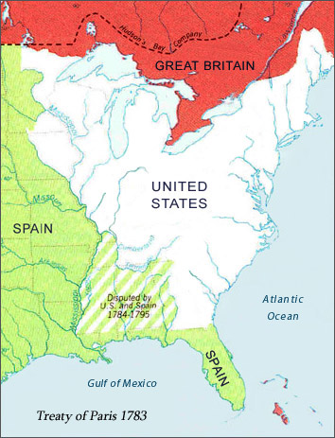
Treaty of Paris, 1783
Confirmed U.S. independence
Set boundaries of new nation
Atlantic Ocean to Mississippi River and Canada to the Florida border.

Slide 58
After the Revolution
Second Continental Congress established
  Articles of Confederation – created the first national government of the 13 colonies in North America
  March, 1781, set up Congress, each state one vote regardless of population.
Problems
  States pursued own interest
  Government no means to raise money (TAXES)
  Government no way to enforce its laws
  No national court system
  Weak central government

Slide 59
Convention lead to end of Articles of Confederation
  James Madison proposes Virginia Plan
    Small states upset!
Great Compromise
Two-house Congress to satisfy both small & large states.
  Each state would have equal representation in Senate “upper house”
    State legislatures would choose members.
  Population of state determined reps in House of Representatives “lower house”
    Voters would choose members.

Slide 60
Federal System – power divided between national and state governments
Separation of Powers
  Legislative branch – makes laws
  Executive branch – carry out laws
  Judicial branch – interpret laws
Established system of “checks & balances”, prevented one branch from dominating the others.
Established electoral college for choosing presidents.
Established means for changing constitution through “amendments”

Slide 61
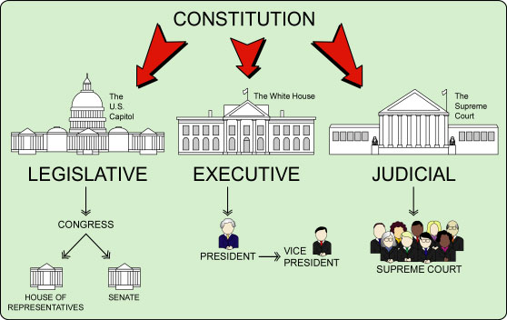
COPY THIS CHART IN YOUR NOTES

Slide 62
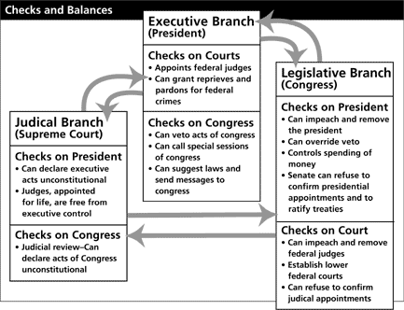

Slide 63
Bill of Rights
First 10 amendments to Constitution
Influenced by Voltaire, John Locke, Jean Jacques Rousseau
First 8 amendments = personal liberties.
  1st Amendment – right to freedom of religion, speech, press, & political activity.
  2nd & 3rd Amendments, can’t be denied right to bear arms as members of a militia of citizen-soldiers, can’t house troops in private homes in peacetime.
4th Amendment, prevents search of citizens homes without proper warrants.
5th through 8th, guarantee fair treatment for individuals accused of crimes.
9th & 10th, impose general limits on powers of federal government.

Slide 64
